Slide 1
Advanced Angular
Building Real-time Server-less Apps with Firebase
Lecture 11
By James(Jin) Wang
10/05/2019

Slide 2
Outline
Create objects
Read objects
Update objects
Delete objects

Slide 3
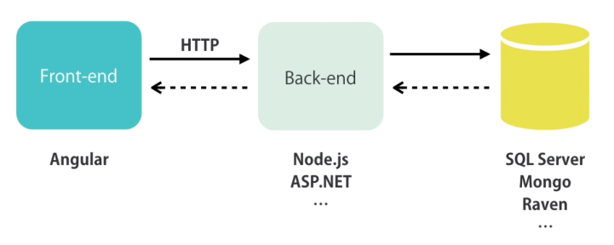
Firebase
  Architecture:

Slide 4
Firebase
  Firebase:
  Fast, scalable and real-time database in the cloud
  Authentication
  Cloud messaging
  Storage
  Analytics

Slide 5
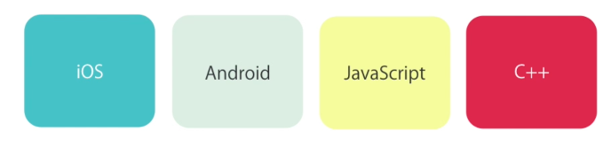
Firebase
  Multiple Platforms:

Slide 6
Firebase
  Working with Firebase Databases:
  console.firebase.google.com
  create a project

Slide 7
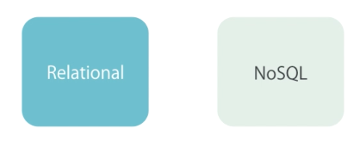
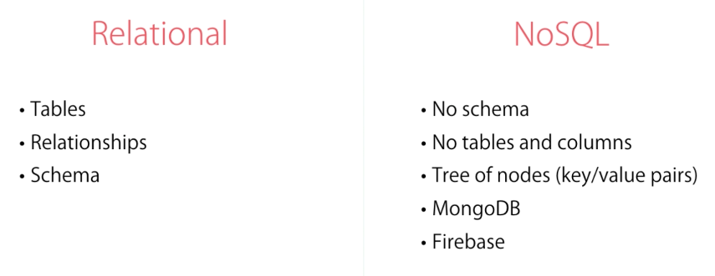
Firebase
  Database:

Slide 8
Firebase
  Install Firebase:
  ng new firebase-demo
  npm install firebase angularfire2 --save
  edit environment.ts and add firebase config
  add: (app.module.ts)
  import { AngularFireModule } from 'angularfire2’;
  import { AngularFireDatabaseModule } from 'angularfire2/database’;
  AngularFireModule.initializeApp(environment.firebase)

Slide 9
Firebase
  Reading Lists:
  add: (app.component.ts)
  import { AngularFireDatabase } from 'angularfire2/database’;
  constructor(db: AngularFireDatabase) {
  db.list('/courses').valueChanges()
  .subscribe(courses => {
  this.courses = courses;
  console.log(this.courses);
  });
  }

Slide 10
Firebase
  Memory Leaks and Unsubscribe:
  add: (app.component.ts)
  import { Subscription } from 'rxjs/Subscription’;
  ngOnDestroy() {
  this.subscription.unsubscribe();
  }

Slide 11
Firebase
  Async Pipe:
  Subscribes
  Gets the latest value
  Unsubscribes
  add: (app.component.ts)
  this.courses$ = db.list('/courses').valueChanges();
  add: (app.component.html)
  <li *ngFor="let course of courses$ | async">

Slide 12
Summary

